Slide 1

Introduction To AI Even Semester Session 2025-26
Handwritten Digit Recognition
Tushar Chandra Pant , Tushar Mishra , Shresth Yadav , Utkarsh Sanre
Project Supervisor:
Supervisor Name: Ms. Komal Salgotra
Designation: Assistant Professor

Slide 2
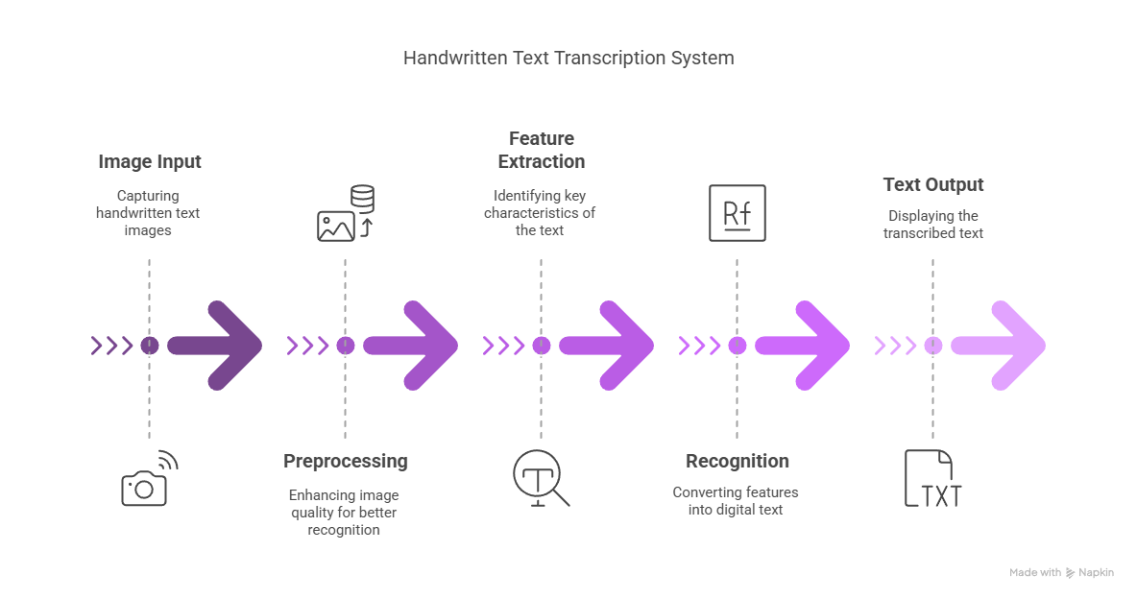
Handwritten Digit Recognition Project
This project focuses on creating a system that turns handwritten digit into digital form. It’s designed to help with tasks like digitizing old documents or processing handwritten forms, aiming to make it easier for researchers, developers, and users to convert handwriting into digit efficiently. The process involves inputting images, preparing them, extracting features, recognizing digit, and producing the final digital digit.

Slide 3
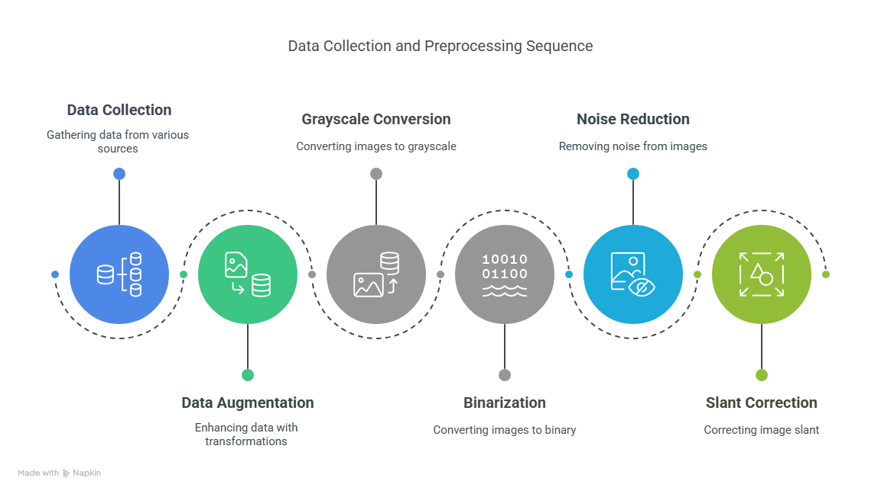
Data Collection and Preprocessing
Our approach involves a comprehensive data collection and preprocessing stage. We utilize established datasets such as MNIST, IAM Handwriting Database, EMNIST, and custom datasets. Data augmentation techniques, including rotation, scaling, skewing, and noise addition, enhance the model's robustness. Preprocessing steps involve grayscale conversion, binarization, noise reduction, and slant correction, implemented using tools like OpenCV and Scikit-image.

Slide 4
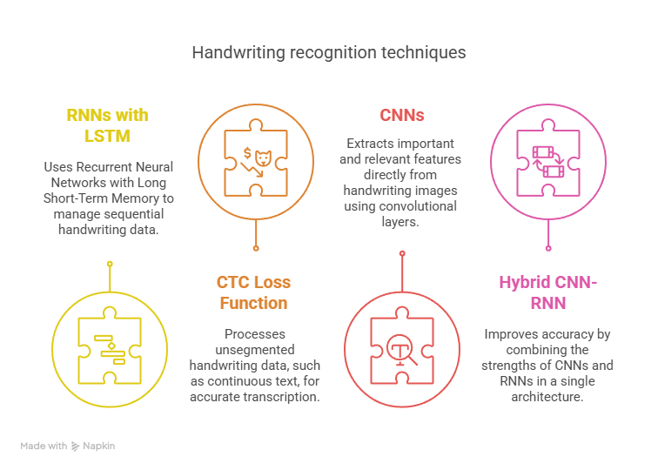
Model Architecture
This handwriting recognition model uses CNNs to extract features from handwriting images and RNNs with LSTM to handle sequential data. It employs the CTC Loss Function for predicting digit from unsegmented data, combining these techniques in a hybrid architecture for high accuracy and efficiency

Slide 5
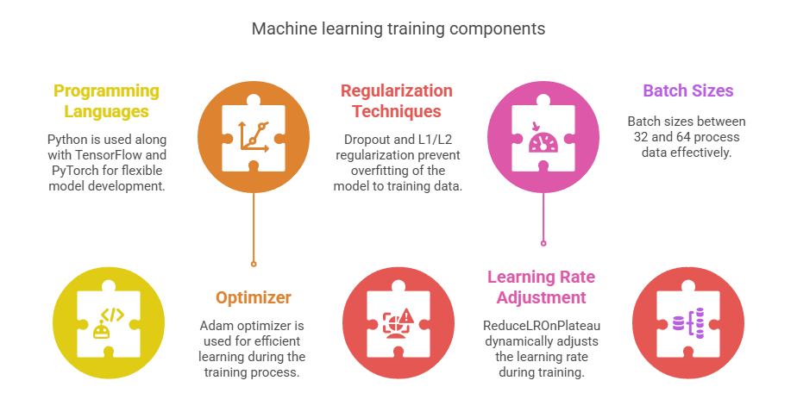
Training Process
This machine learning training setup uses Python, TensorFlow, and PyTorch for flexibility. The Adam optimizer ensures efficient learning, while techniques like Dropout and L1/L2 regularization help prevent overfitting. The learning rate is adjusted using ReduceLROnPlateau, and batch sizes range from 32 to 64 for processing data effectively

Slide 6
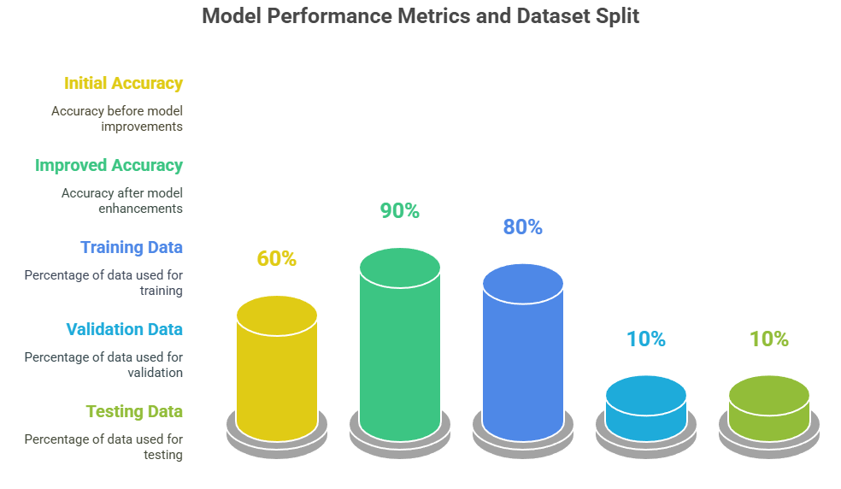
Evaluation Metrics
The model's performance is measured using two main metrics: Character Error Rate (CER), which is the primary metric, and Word Error Rate (WER), which is the secondary one. The dataset is split into 80% for training, 10% for validation, and 10% for testing to ensure accurate evaluation. Initially, accuracy was around 60%, but with improvements, it exceeded 90% on specific datasets

Slide 7
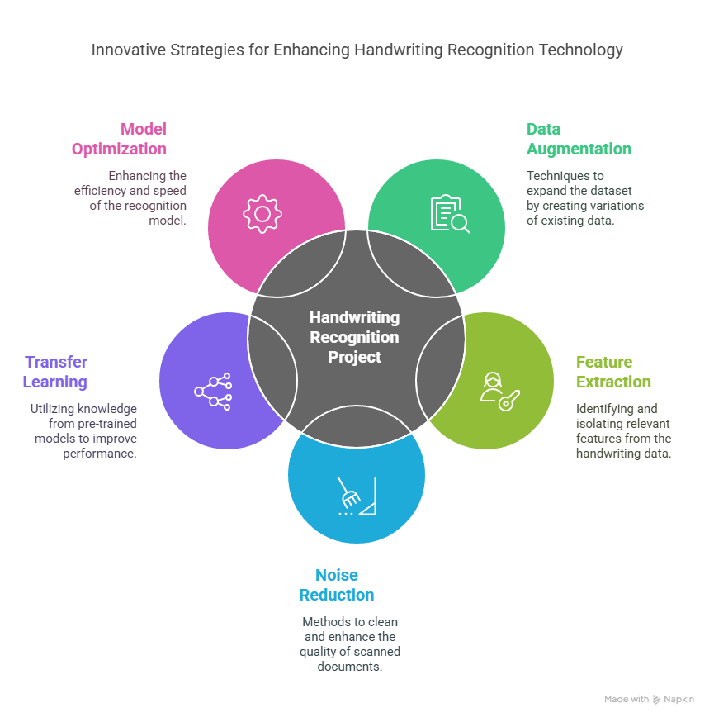
Challenges and Solutions
This project solved key challenges in handwriting recognition. To handle different handwriting styles, it used data augmentation and feature extraction. Noise in scanned documents was reduced with preprocessing techniques. Limited training data was boosted with transfer learning and synthetic data. Computational complexity was managed through model optimization and GPU acceleration.

Slide 8
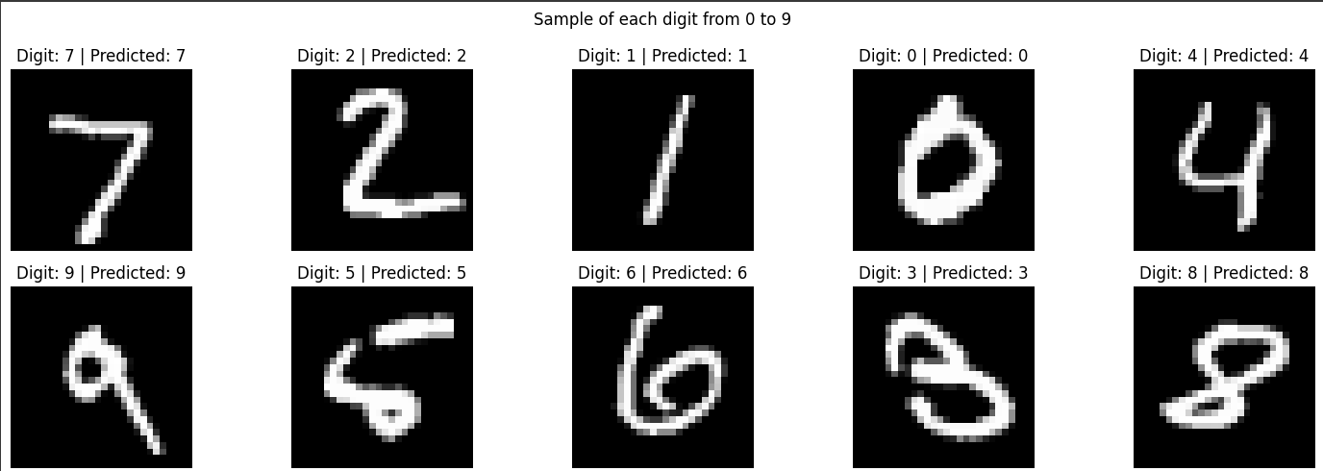
Conclusion
This project successfully created a highly accurate system for recognizing handwritten digit using deep learning. It demonstrated the effectiveness of these methods and opens up opportunities for further advancements in document processing and digit recognition.

